Slide 2
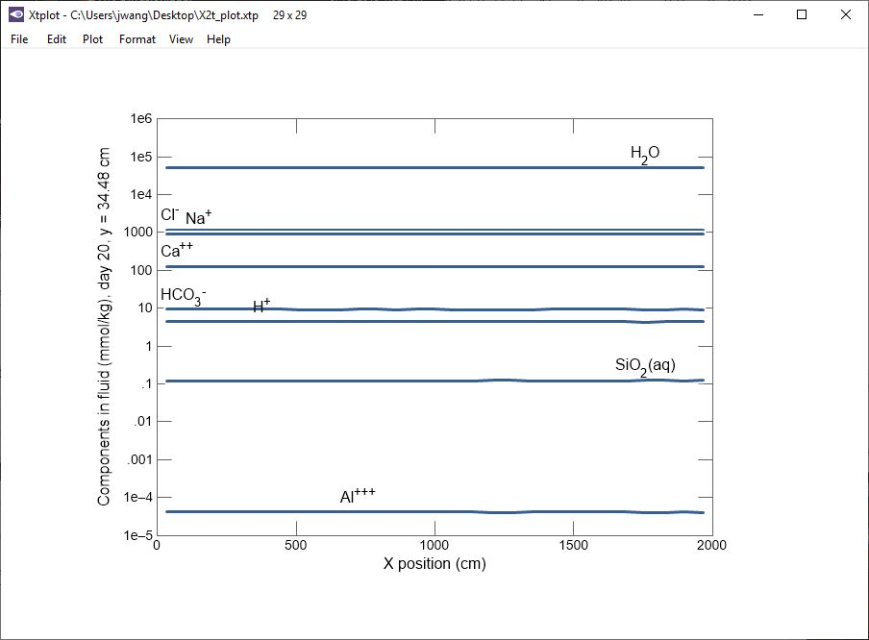
Switch to Map View to enable color maps, color masks, or contour plots
Plot → Map View

Slide 3
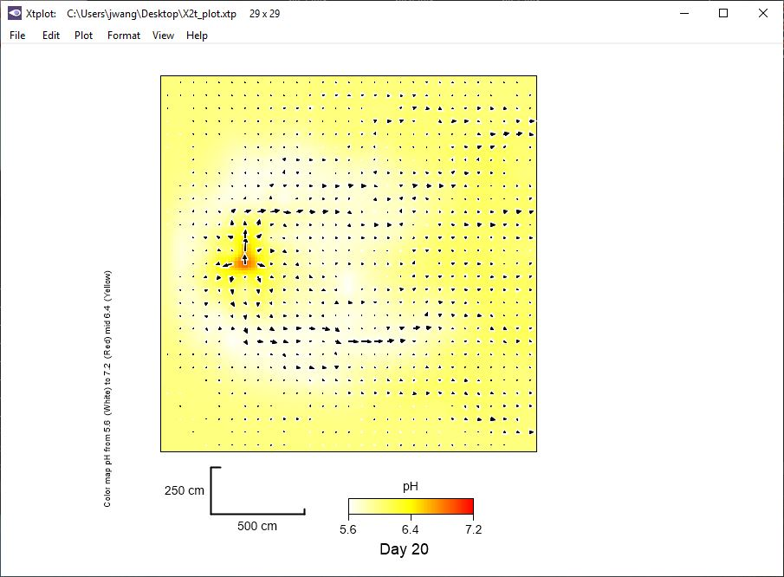
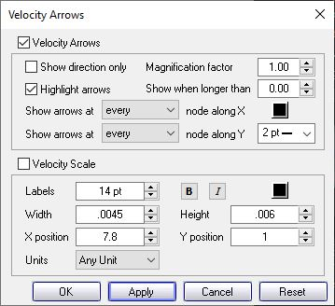
Format → Velocity Arrows
Check box to display velocity arrows

Slide 4
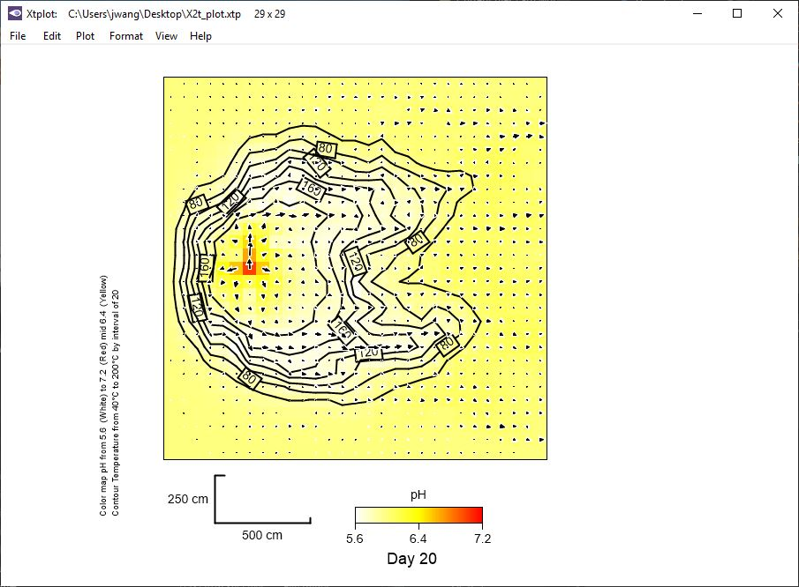
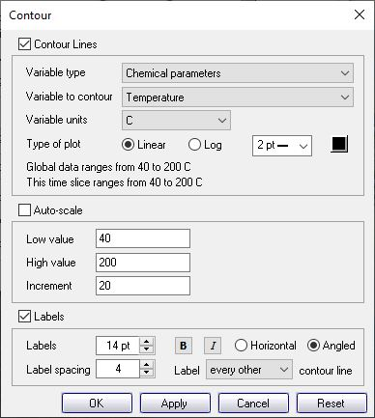
Use Xtplot to contour parameters like temperature, hydraulic potential, concentration, fugacity, or mass of any species, gas or mineral
Format → Contour…
Check box to display contour line for variable
Uncheck to adjust contour value and increments

Slide 5
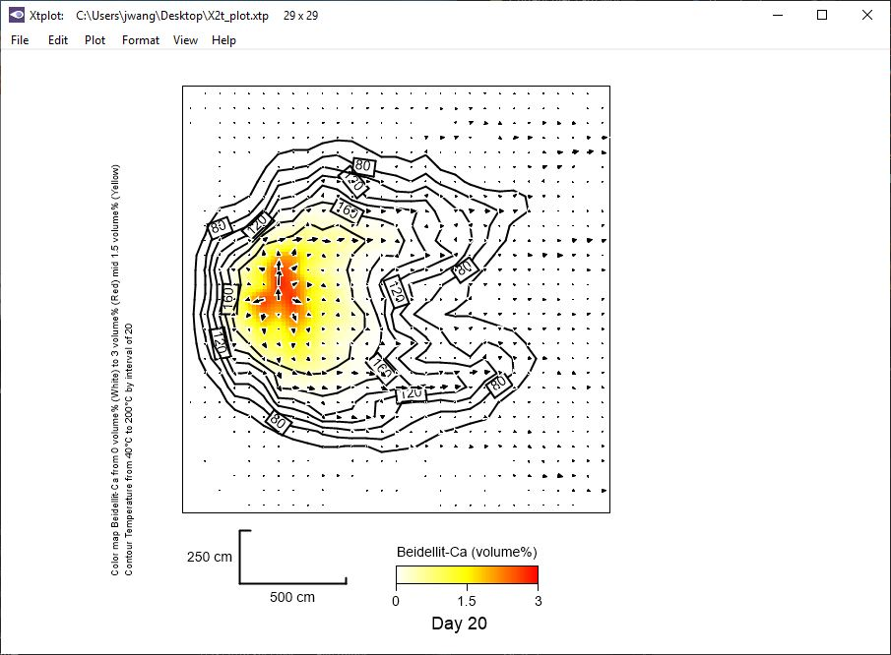
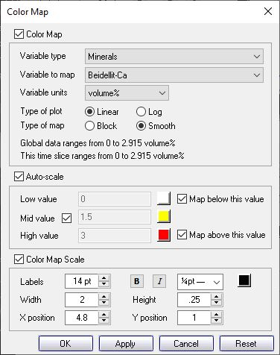
Format → Color Map…
Check box to display color map for variable

Slide 6
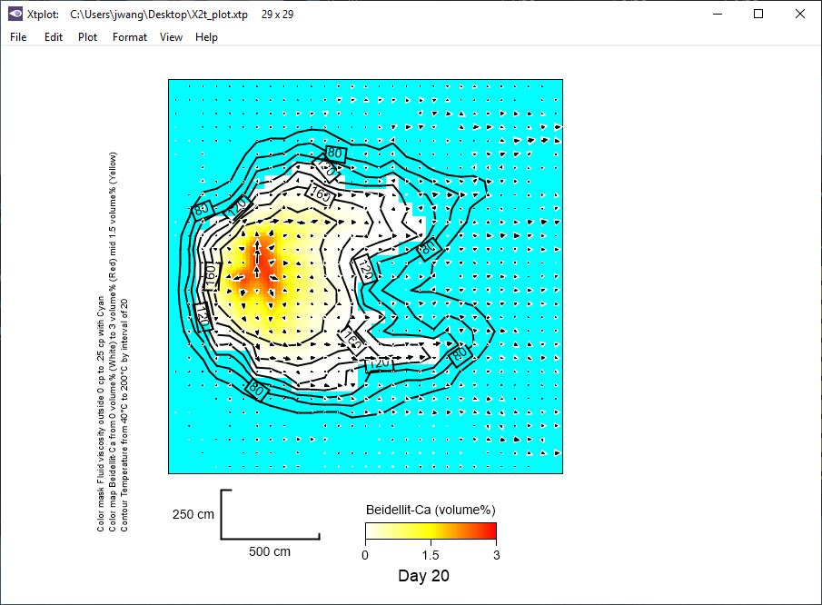
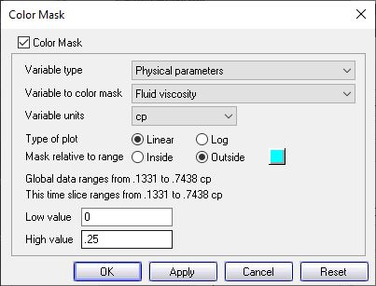
Format → Color Mask…
Use color mask to display where the fluid viscosity exceeds a threshold value
Set unit value range

