Slide 1
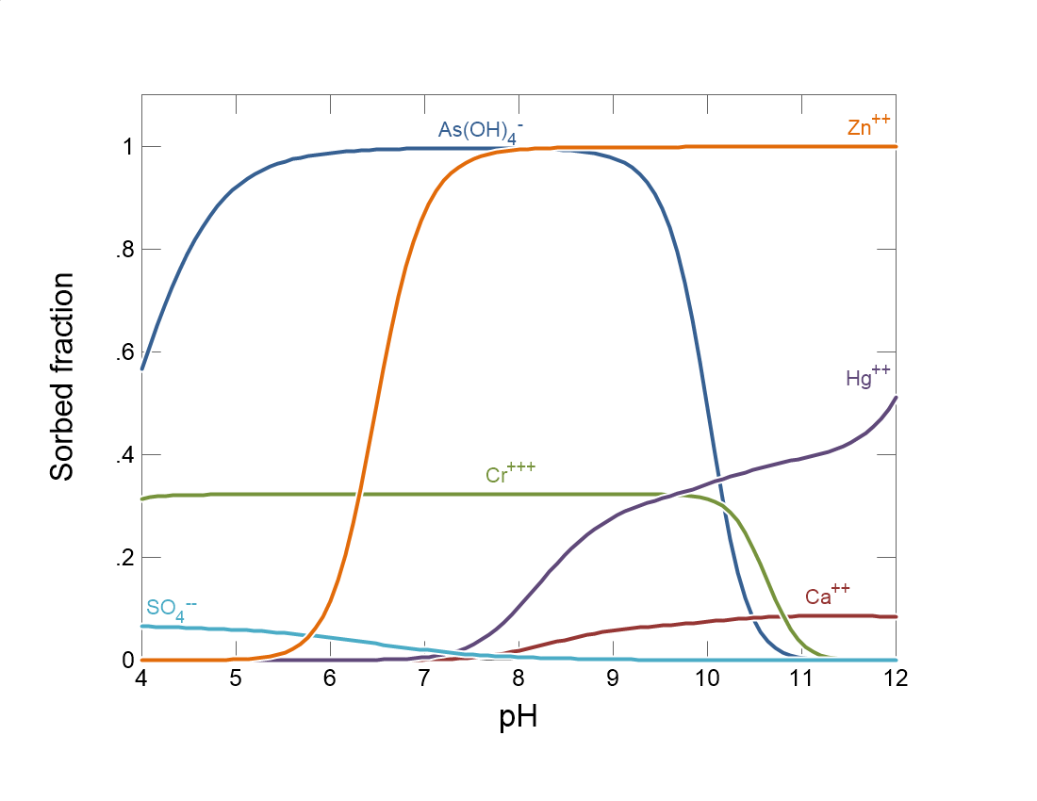

Slide 2
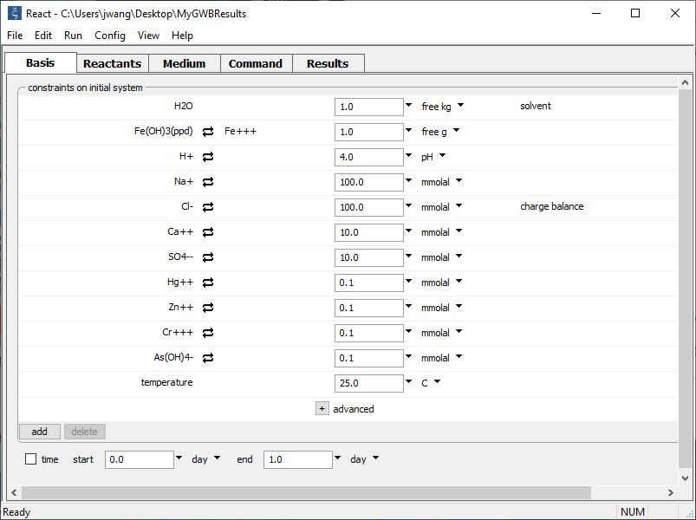
Set the initial fluid composition on the Basis pane.
pH 4 fluid containing heavy metals is in equilibrium with sorbing mineral.

Slide 3
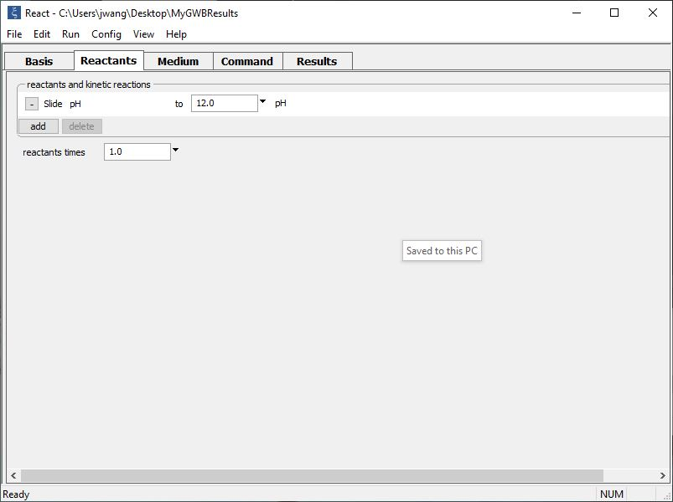
Set up a sliding activity path on the Reactants pane.
pH will be adjusted from initial value, 4, to the target value of 12 set here
add → Sliding → pH

Slide 4
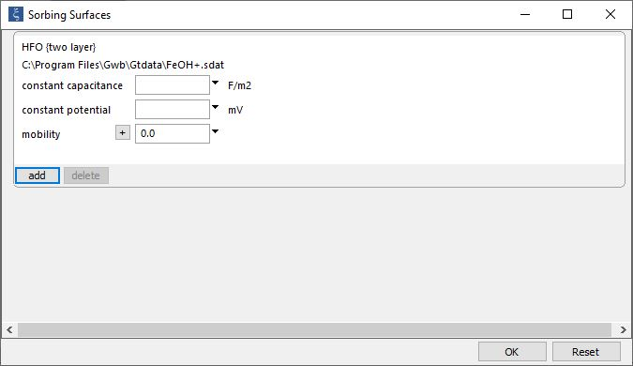
We load a surface dataset that describes how ions sorb to the mineral in our system
File → Open → Sorbing surfaces…
Surface complexation dataset for hydrous ferric oxide.
You can add any number of sorbing surfaces.

Slide 5
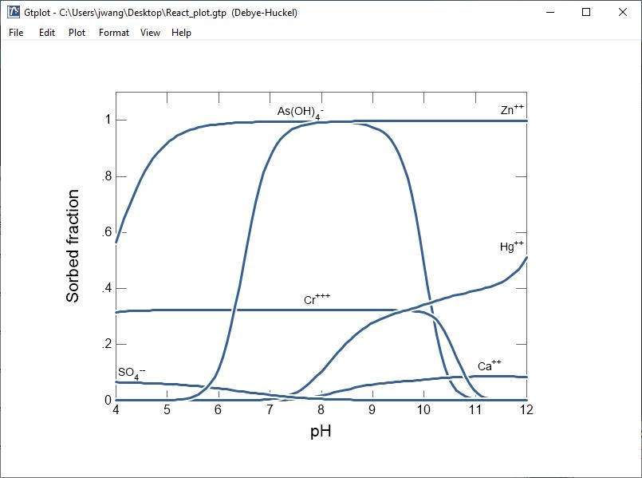
A sliding pH path is a fast way to show how sorption behavior changes with pH

