Slide 1
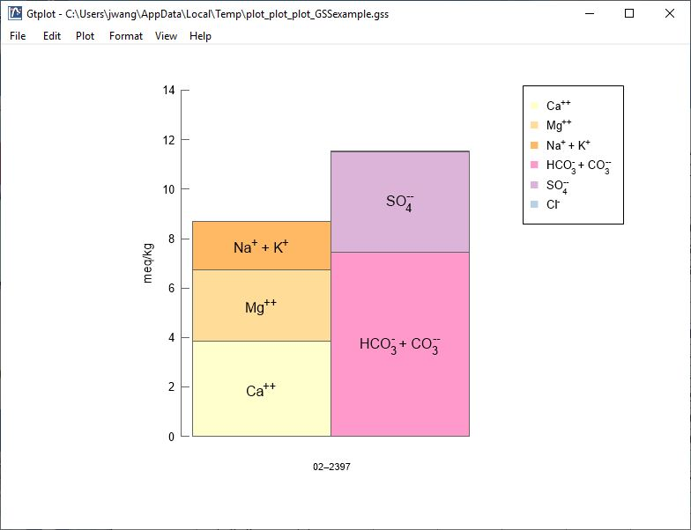
Bar Chart

Slide 2
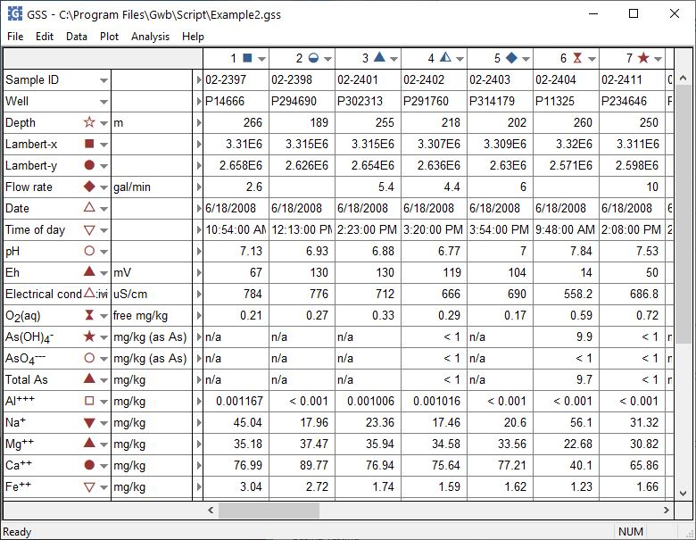
You can launch Gtplot from GSS to create Bar Charts and other specialty plots.
Plot → Bar Chart…

Slide 3
The Bar chart shows the fluid’s cation-anion balance graphically.
Right-click on labels or axes to change color, font, size, etc.
Double-click on plot to bring up the Bar Chart configuration dialog.
Double-click outside the plot to open the Quick Toggle dialog. Toggle sample labels, legend, and more.

Slide 4
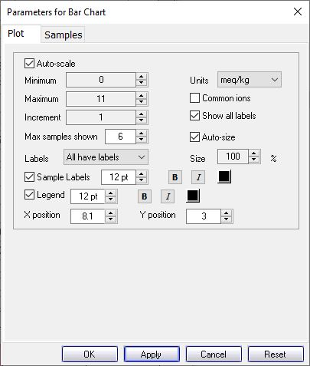
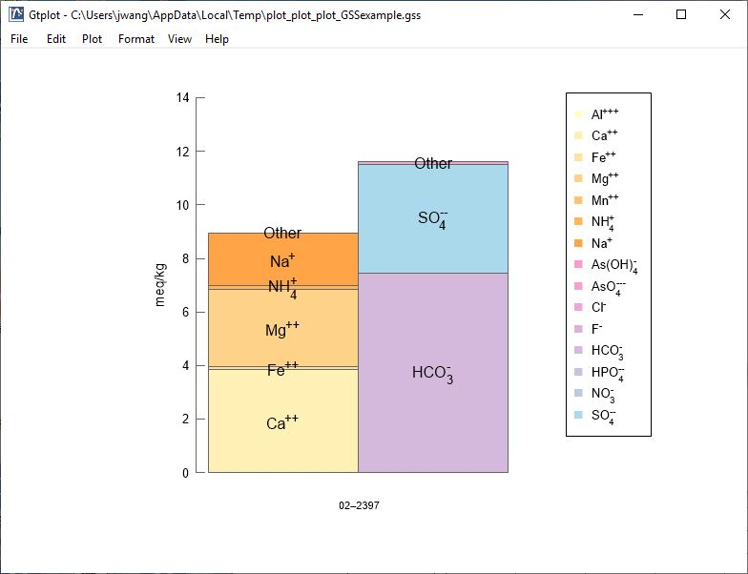
You control details of the Bar Chart from the Plot pane.
Uncheck “Common ions” and check “Show all labels” to include minor ions.
Set number of samples to plot in Block
Minor ions Fe⁺⁺, NH₄⁺, others are plotted.

Slide 5
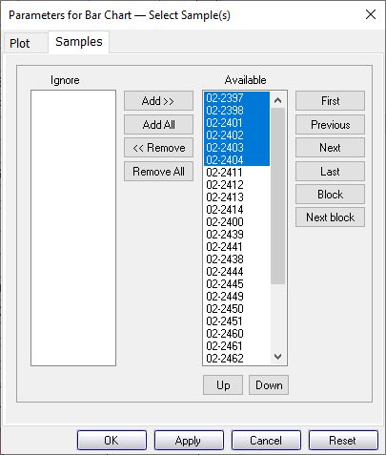
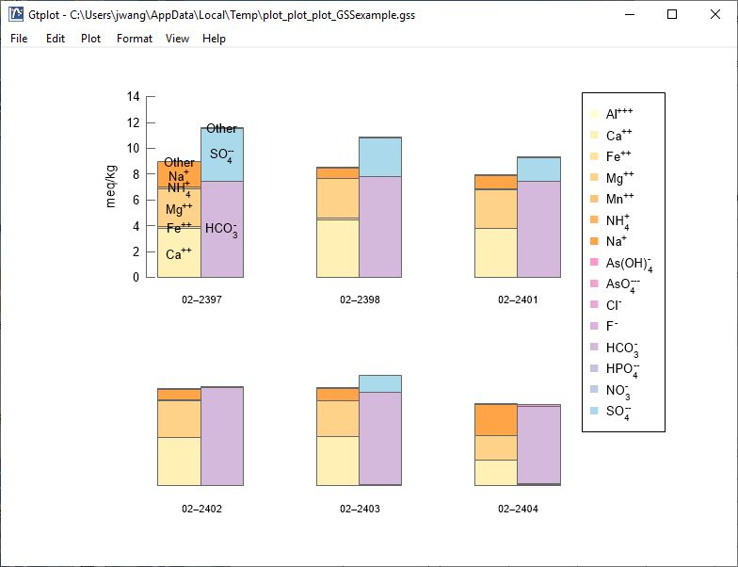
You can cycle through samples one at a time…
You control which samples are displayed from the Samples pane.
Use Block, Next block to cycle through groups of samples. “Max samples shown” was set to 6 on the Plot pane.
Select the samples to plot.

