Slide 1
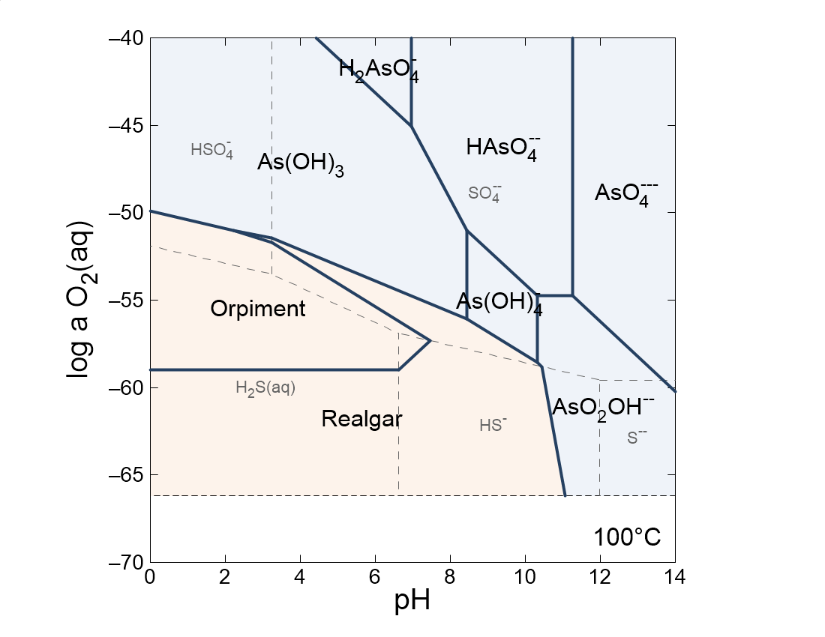

Slide 2
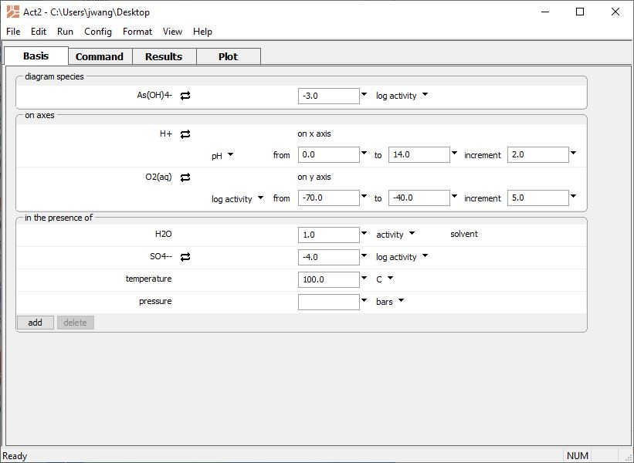
Configure a redox-pH diagram for Arsenic
Account for SO₄²⁻ by adding it to the “in the presence of” section
Run → Go
draws the diagram

Slide 3
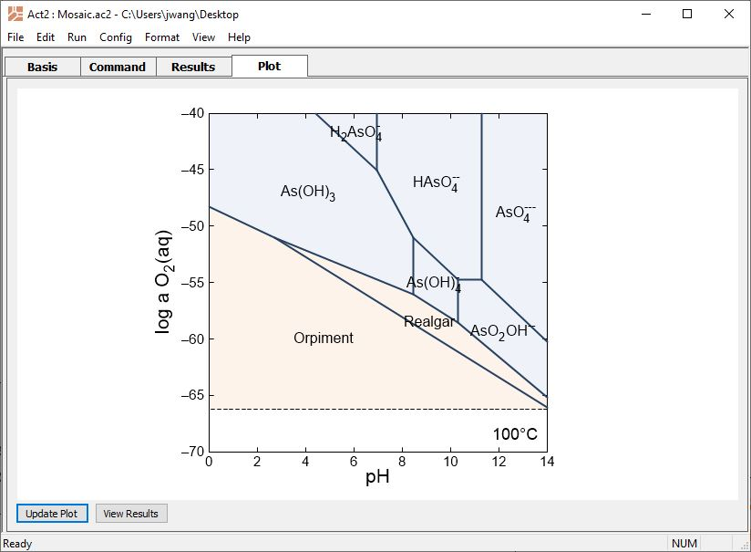
The diagram by default assumes speciation of the SO₄²⁻ ligand does not change with pH or oxidation state
You can return to the Basis pane to modify your diagrams if necessary

Slide 4
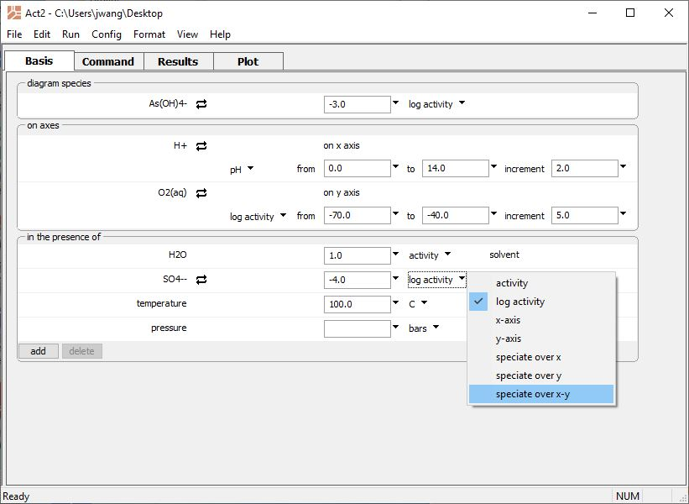
Click on SO₄²⁻ unit pulldown and select “speciate over x-y”
Run → Go
updates the diagram

Slide 5
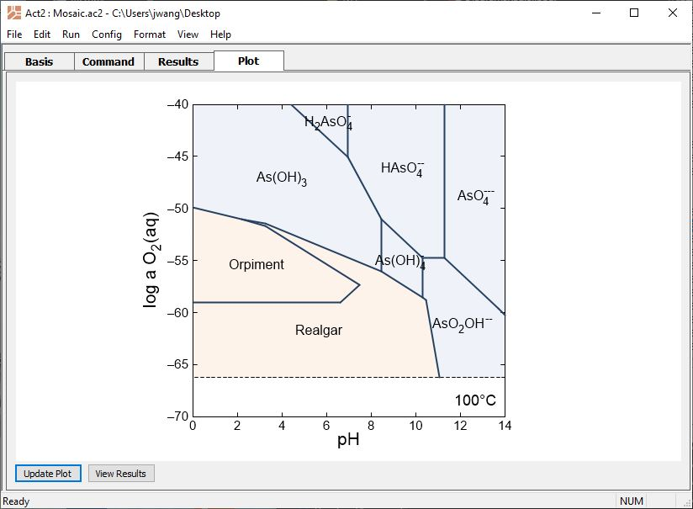
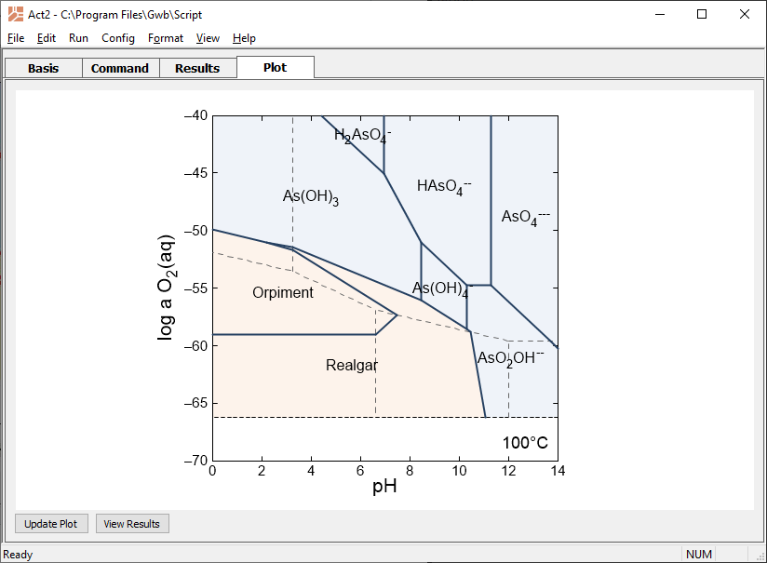
New plot accounts for changing SO₄²⁻ speciation. Note how Orpiment and Realgar stability fields changed.

Slide 6
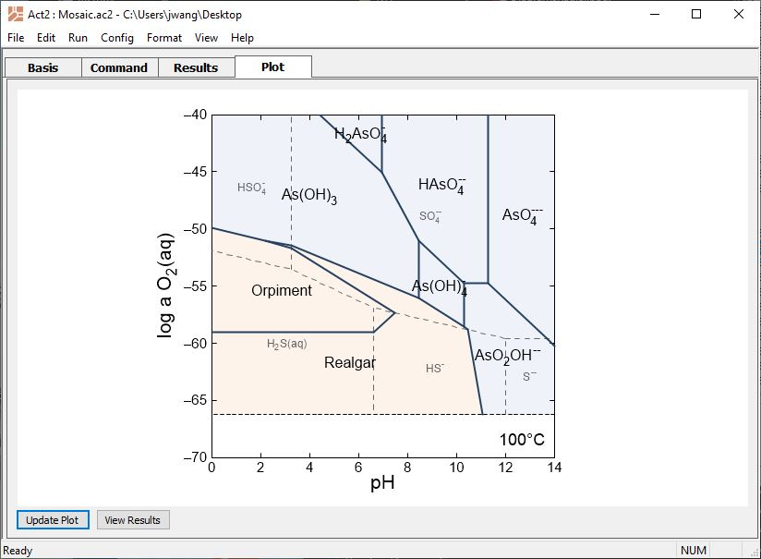
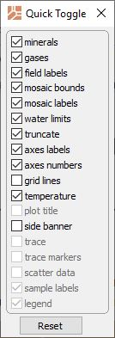
Format → Quick Toggle… → check mosaic labels
Dashed lines show boundaries of the speciating ligand.
Mosaic labels show predominant form of the SO₄²⁻ ligand.

