Slide 2
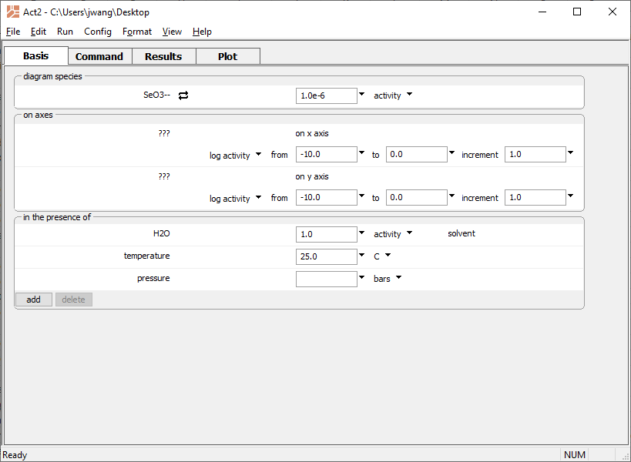
Configure your diagram on the Basis pane
Select main species to diagram
Set activity

Slide 3
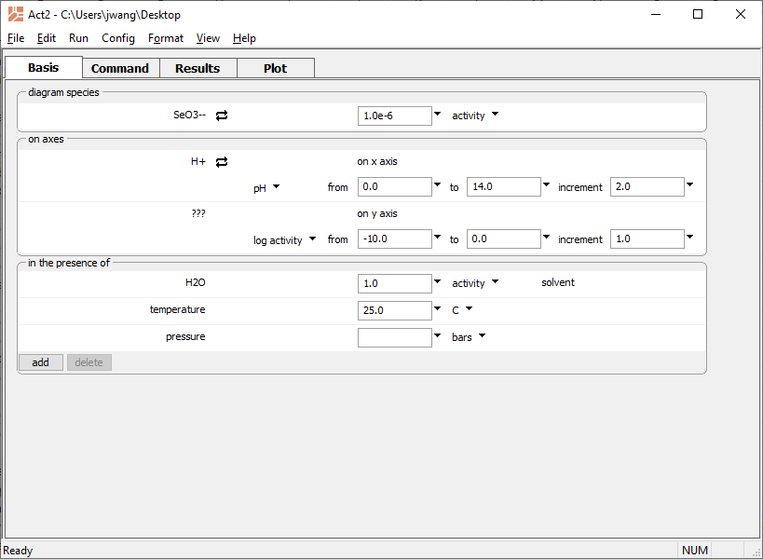
Choose H⁺ for x axis
Set pH units

Slide 4
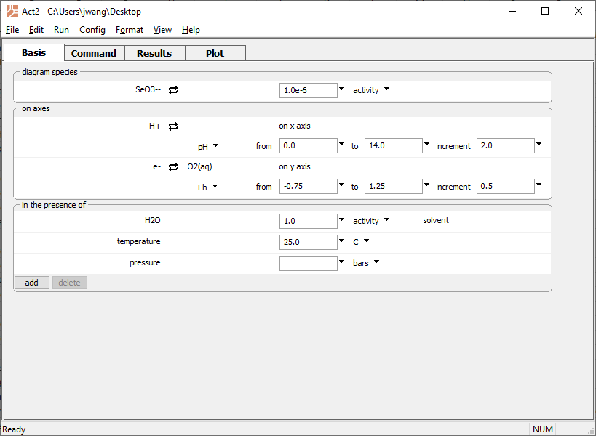
Choose O₂(aq) for y axis, then swap in the e⁻
Set Eh units

Slide 5
Set temperature
Add any background ions
Run → Go
draws the diagram

Slide 6
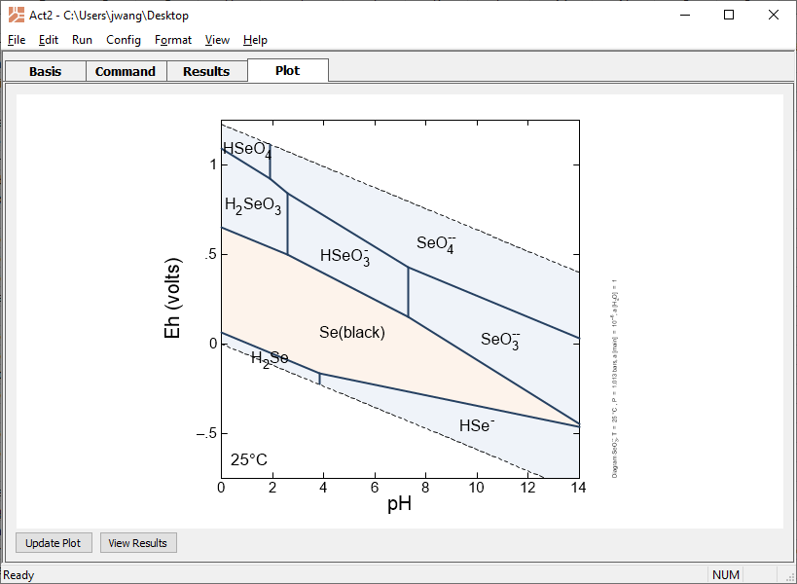
Move to the Plot pane.
Minerals plot in orange, aqueous species in blue
You can copy the diagram to the clipboard and paste into your documents

