Slide 1
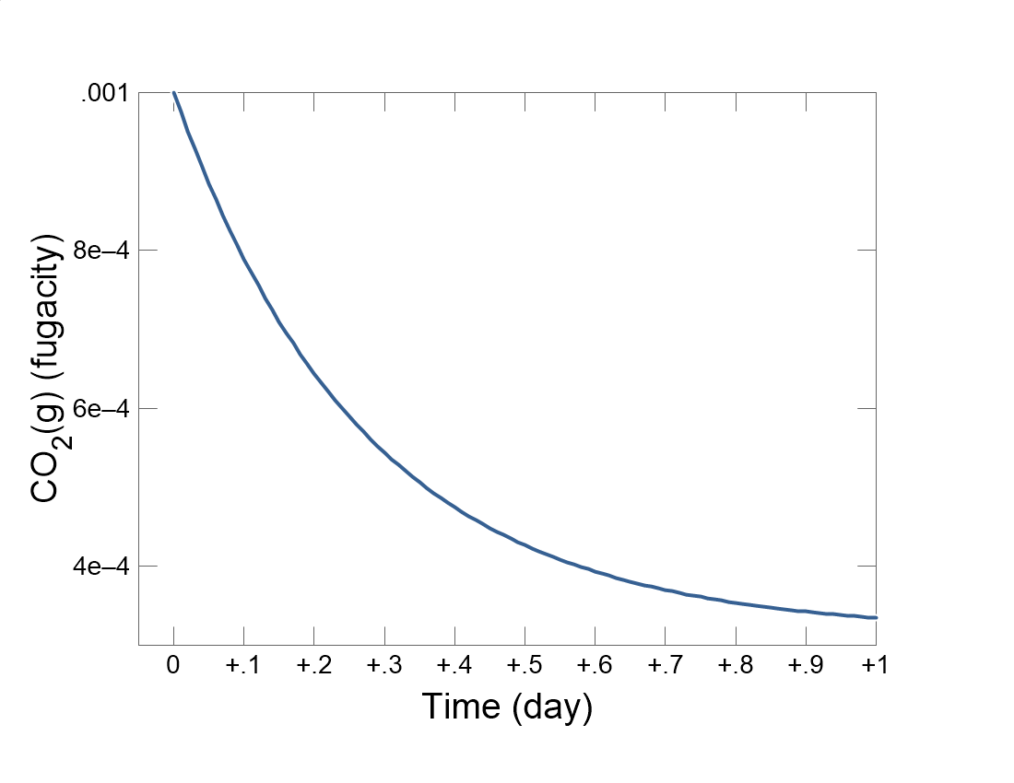

Slide 2
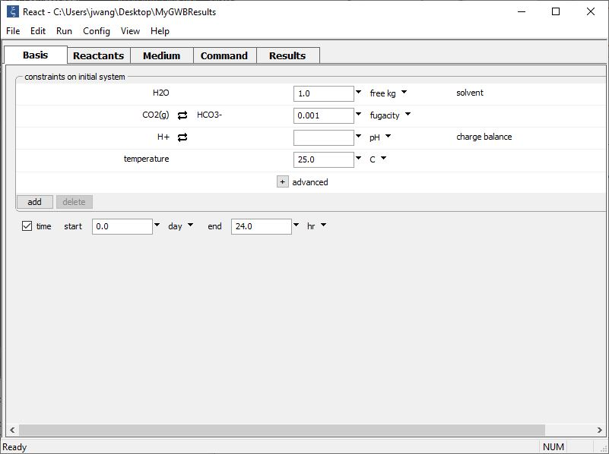
Set the composition of the initial fluid on the Basis pane.
Initial CO₂ fugacity of the fluid
Set the simulation’s duration

Slide 3
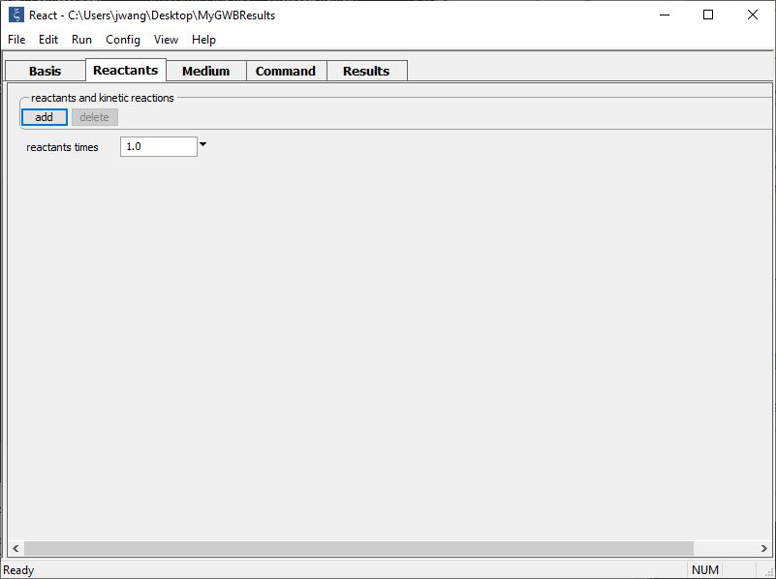
Set up a kinetic rate law on the Reactants pane.
add → Kinetic →
Gas transfer… CO2(g)

Slide 4
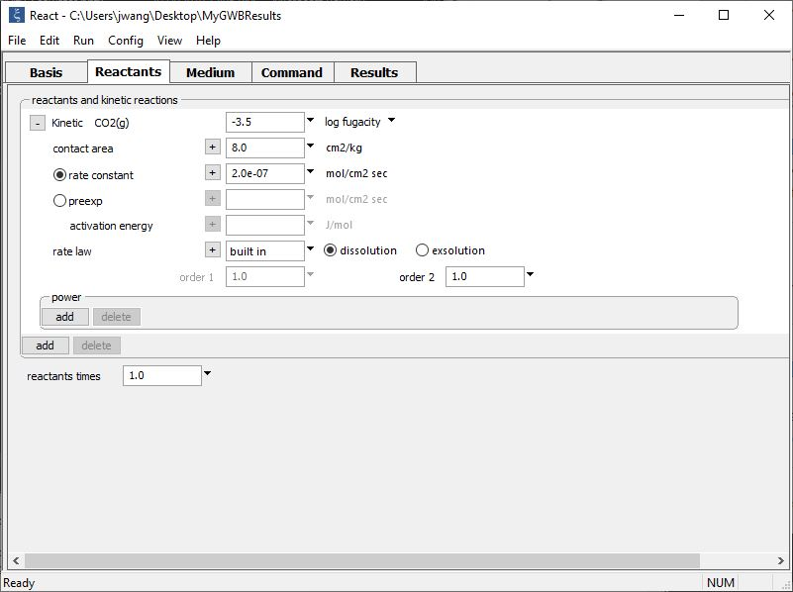
Supply kinetic parameters
CO₂ fugacity in external reservoir (the atmosphere)
Specific interfacial area for gas transfer
Rate constant

Slide 5
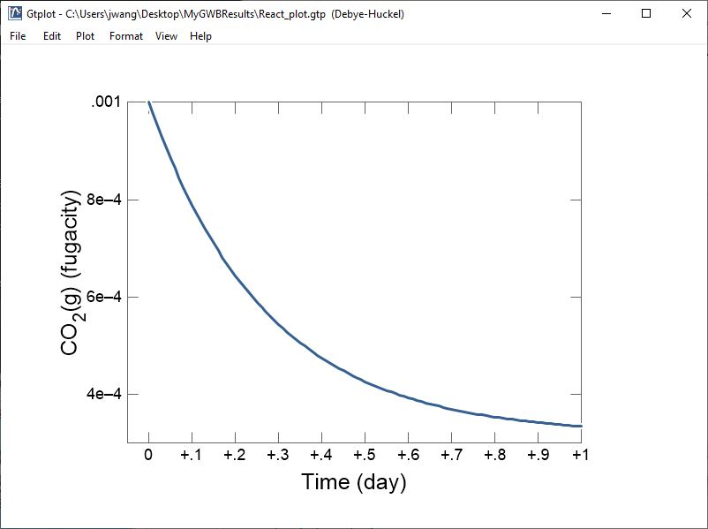
The fluid exsolves CO₂ as it approaches equilibrium with the atmosphere

